Slide 1
PROBABILITY AND
STATISTICS

Slide 2
GROUP MEMBERS :-
ABDUL BASIT
MUHAMMAD ANAS HASSAN
MUHAMMAD WARZAN

Slide 3
COVID-19 SURVEY OF
WHO REGIONS

Slide 4
ABSTRACT / BRIEF SUMMARY :-
As we all know that covid-19 disease has emerged in December 2019 and has impacted many countries and billions of people suffered from this .
It has become a worldwide pandemic and a global public thread
with no proper vaccine which became a cause of death of
millions of people .
And in our project we have made a deep analysis of several countries suffering from this worldwide pandemic .

Slide 5
OBJECTIVE AND DATA COLLECTION
METHODOLOGY :-
We have performed analysis on 45 countries of the world by grouping them into 15 countries on the basis of WHO regions namely :-
Europe
Africa
America
We have taken this dataset from kaggle website reporting the situation of
January and February
URL:
https://www.kaggle.com/datasets/imdevskp/corona-virus-report

Slide 6
QUANTITAVE VARIABLES :-
Confirmed Cases 8. Deaths / 100 Cases
Deaths 9. Recovered / 100 Cases
Recovered Cases 10. Confirmed Last Week
Active Cases 11. 1 Week Change
New Cases 12. 1 Week % Increase
New Deaths
New Recovered

Slide 7
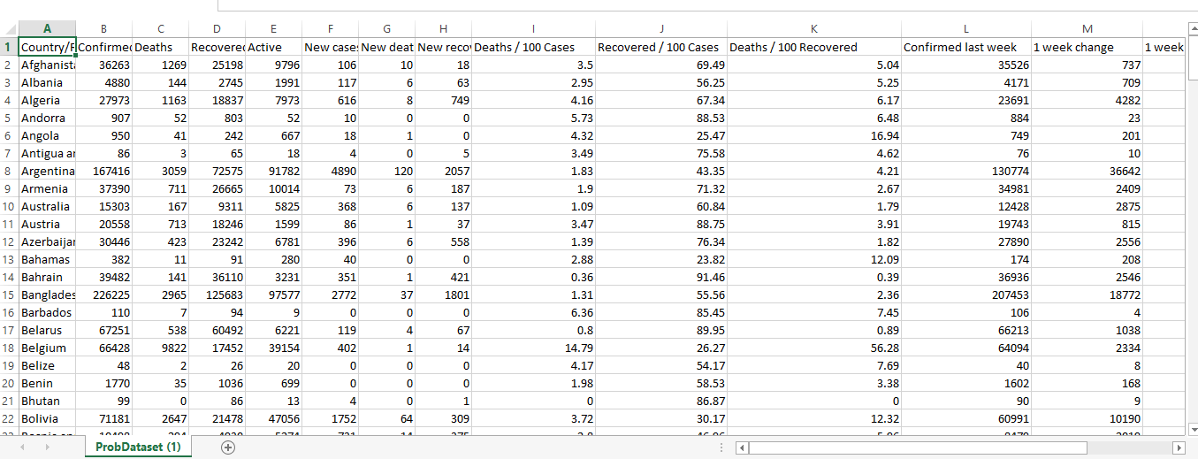
DATASET :-

Slide 8


Slide 9
DESCRIPTIVE AND STATISTICAL ANALYSIS
The European countries are :
Albania 9. Bulgaria
Andorra 10. Croatia
Armenia 11. Cyprus
Austria 12. Czechia
Azerbaijan 13. Denmark
Belarus 14. Estonia
Belgium 15. Finland
Bosnia

Slide 10
Belarus is one of the countries of the Europe where large number of cases were confirmed in Jan 2020 i.e. 67251 cases . It occupies a peak in Europe.
Secondly Belgium is found to be have increasing number of cases and reaching to the peak with Europe
One the other hand Cyprus , Estonia and Andorra are the countries where there is less spread of covid-19 cases and the situation is highly controlled as compared to Belgium and Belarus
We can clearly analyze it through a simple bar chart of confirmed cases of this region

Slide 11
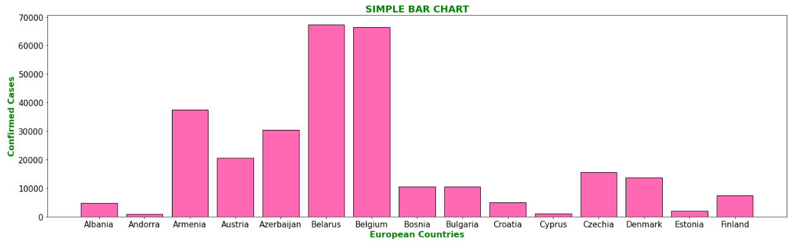

Slide 12
As discussed previously that the situation in Belgium and Belarus was out of control
But the death rate in Belgium was very high as compared to Belarus .
Although Belarus has many patients that are infected from this virus but on the other hand they were healed at a faster rate as compared to Belgium and
other countries .
Fortunately Cyprus ,Andorra and Estonia are on the safe side with less active and deaths cases and mostly recovered cases

Slide 13
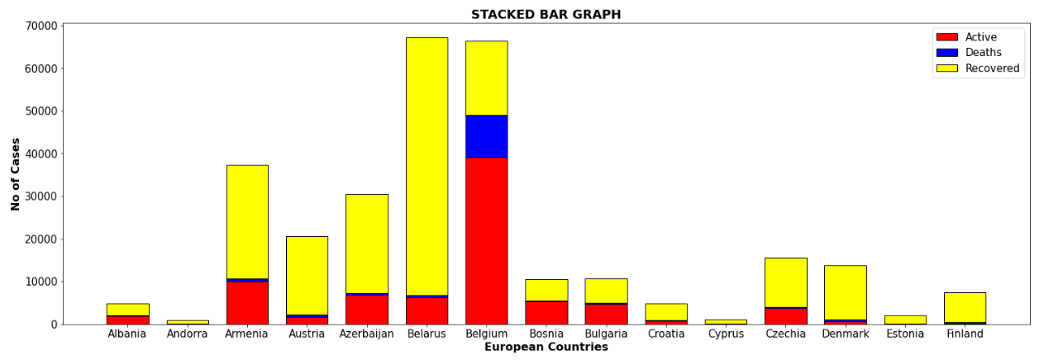

Slide 14
In the month of February Bosnia has the large number of active cases as compared to Belgium and Belarus.
Death rate in whole Europe was very less and mostly cases were healed as compared to the report of January .
Whereas the countries where the situation was controlled in January were still safe from this virus means no change .

Slide 15
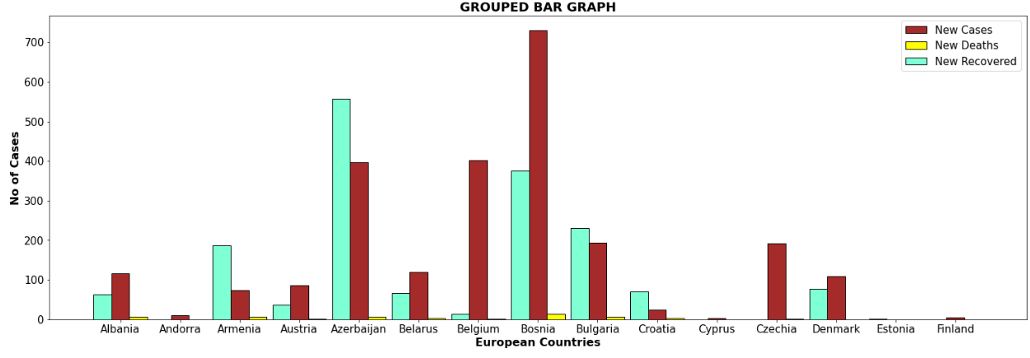

Slide 16
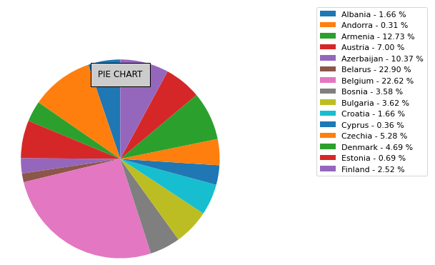
PIE CHART OF DEATHS / 100 CASES

Slide 17
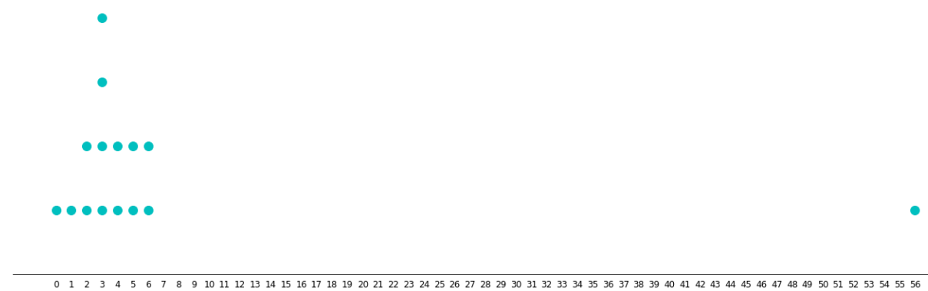
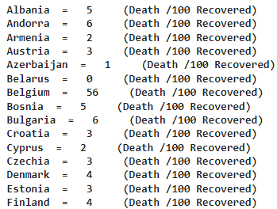
DOT PLOT OF DEATHS / 100 RECOVERED

Slide 18
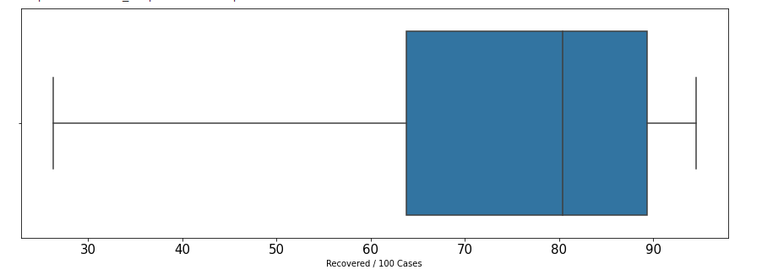
BOX PLOT OF RECOVERED / 100 CASES

Slide 19
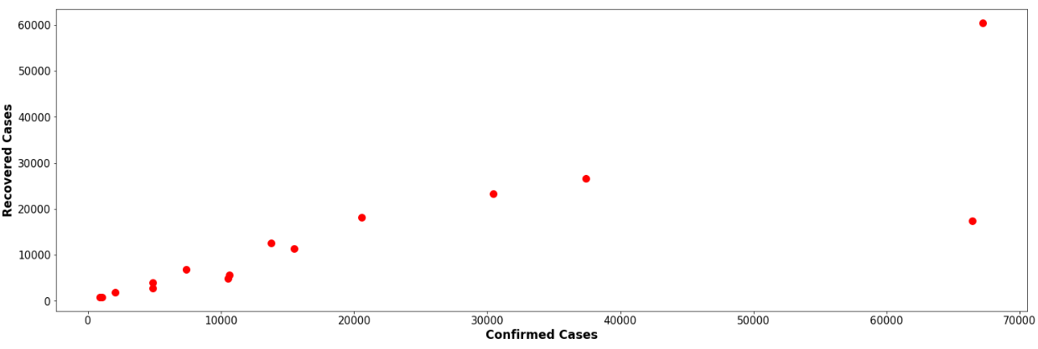
SCATTER PLOT B/W CONFIRMED
AND RECOVERED CASES

Slide 20
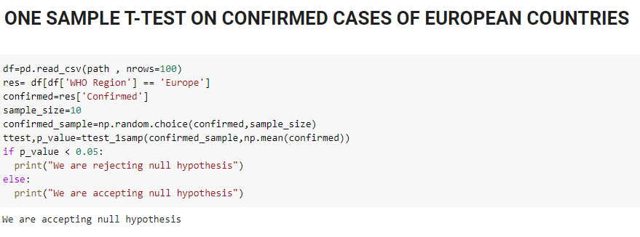
HYPOTHTETICAL TESTING

Slide 21
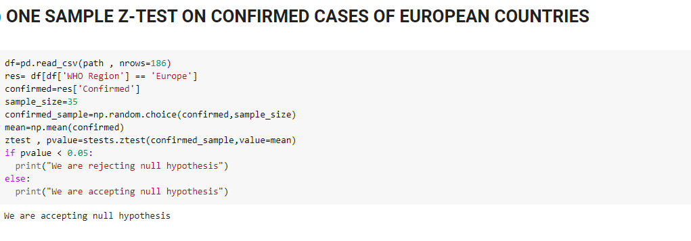

Slide 22
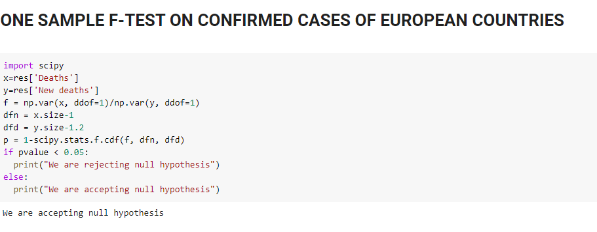

Slide 23
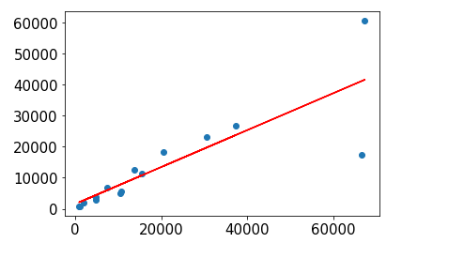
LINEAR REGRESSION B/W CONFIRMED
AND RCOVERED CASES

Slide 24
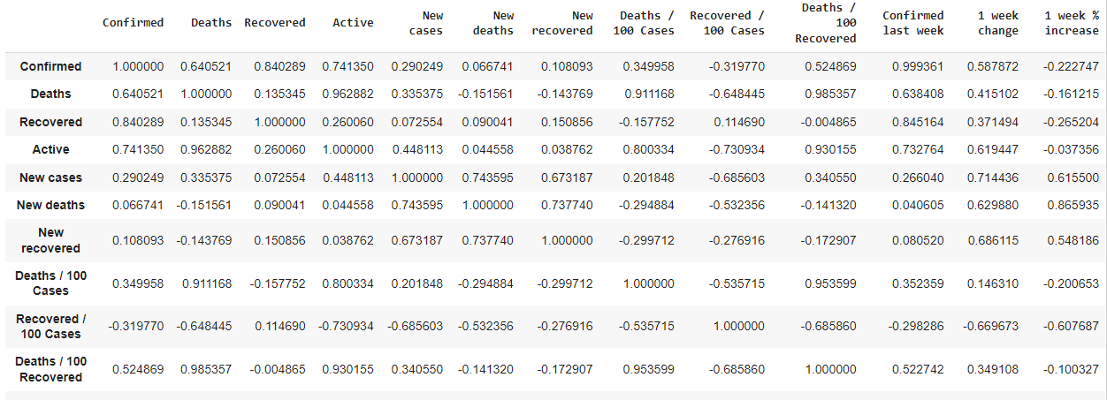
CORRELATION :-

Slide 25
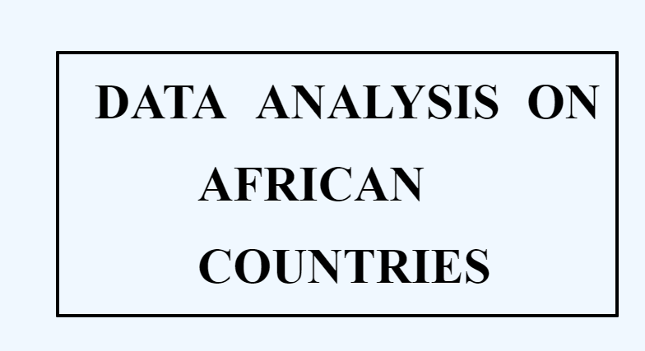

Slide 26
DESCRIPTIVE AND STATISTICAL ANALYSIS
The African countries are :
Algeria 9. CAR
Angola 10. Chad
Benin 11. Comoros
Botswana 12. Brazzaville
Burkina 13. Kinshasa
Burundi 14. Guinea
Cabo Verde 15. Cote d’ Ivoire
Cameroon

Slide 27
Algeria is one of the countries of the Africa where large number of cases were confirmed in Jan 2020 i.e. It occupies a peak in Africa.
Secondly Cameroon and Cote d’ Ivoire are found to be have increasing number of cases and reaching to the peak with Africa
One the other hand Angola , Benin and the rest of the countries have less spread of covid-19 cases and the situation is highly controlled as compared to Belgium and Belarus
We can clearly analyze it through a simple bar chart of confirmed cases of this region

Slide 28
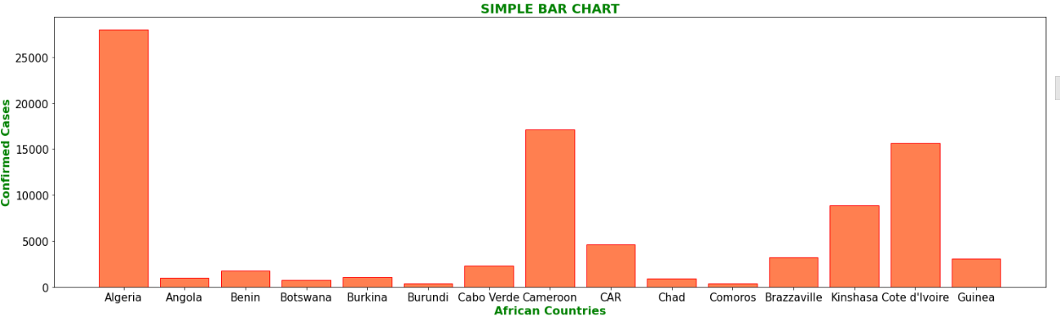

Slide 29
As discussed previously that the situation in Algeria ,Cameroon and Cote d’Ivoire was out of control but the death rate in Algeria was out of control as compared to others
Although Cameroon and Cote d’ Ivoire has many patients that are infected from this virus but on the other hand they were healed at a faster rate as compared to Algeria and
other countries .
Fortunately the rest of the countries are on the safe side with less active and deaths cases and mostly recovered cases

Slide 30
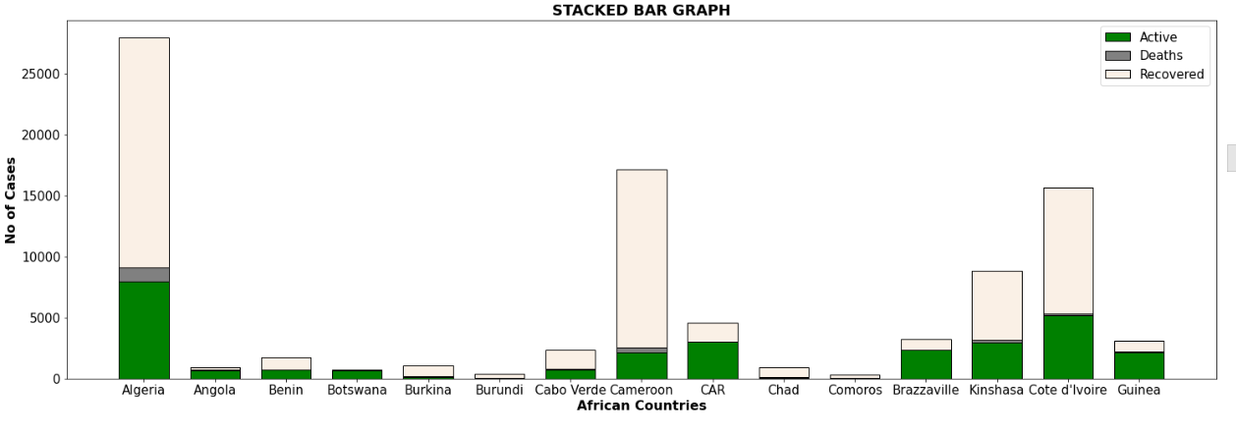

Slide 31
In the month of February the situation of Algeria was far from satisfactory and has the largest number of cases reported but the recovery ratio was much better than that of january
Death rate in whole Africa was very less and mostly cases were healed as compared to the report of January .
Whereas the countries where the situation was controlled in January were still safe from this virus means no change .

Slide 32
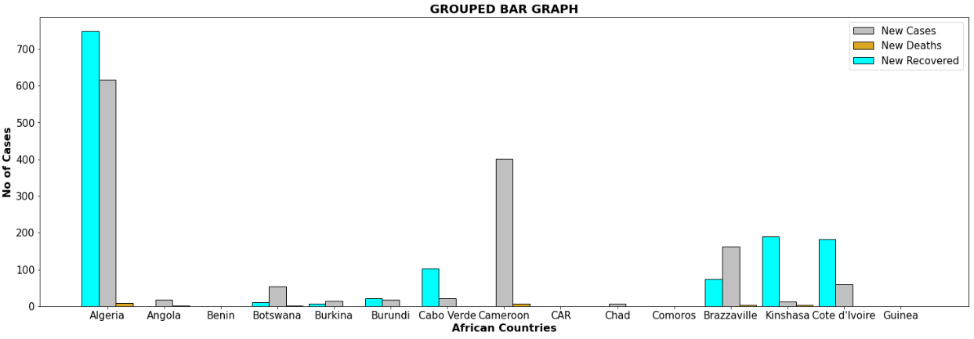

Slide 33
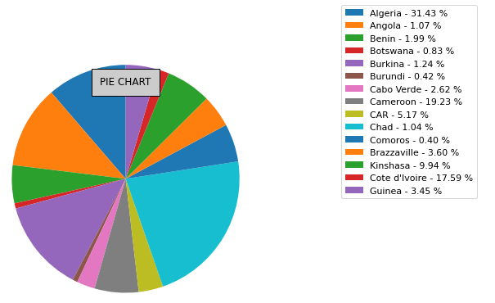
PIE CHART OF DEATHS / 100 CASES

Slide 34
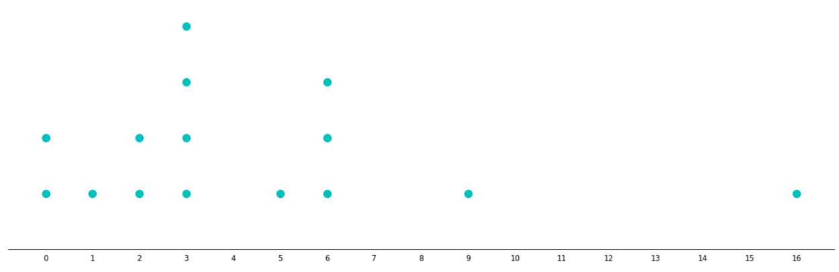
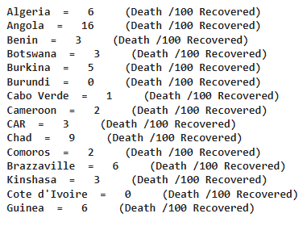
DOT PLOT OF DEATHS / 100 RECOVERED

Slide 35
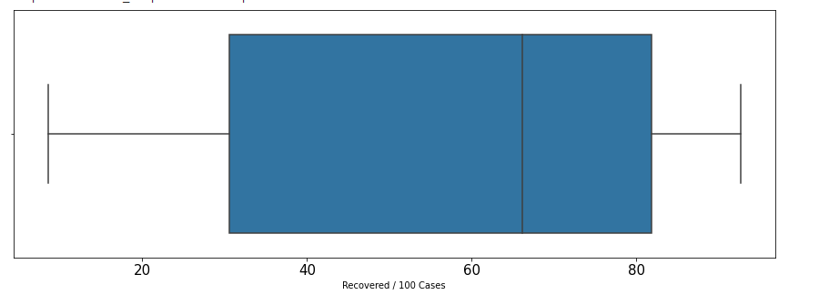
BOX PLOT OF RECOVERED / 100 CASES

Slide 36
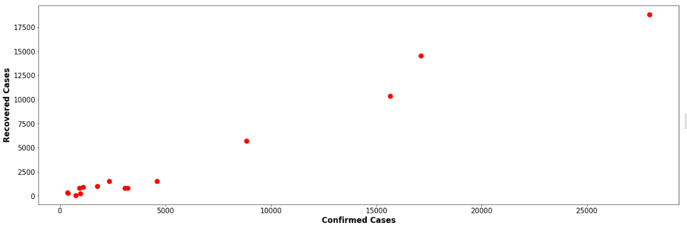
SCATTER PLOT B/W CONFIRMED
AND RECOVERED CASES

Slide 37
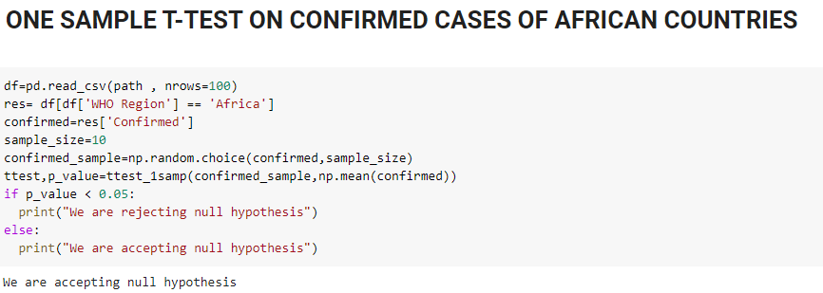
HYPOTHTETICAL TESTING

Slide 38
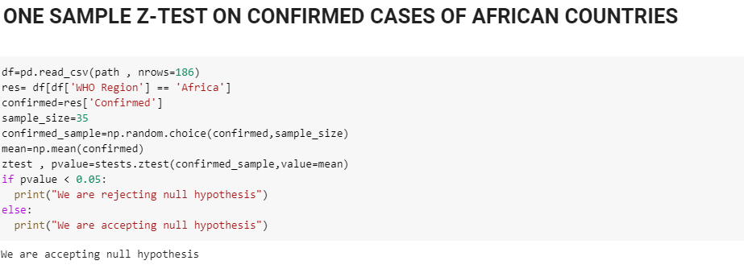

Slide 39
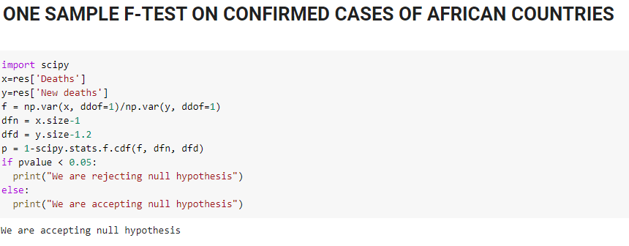

Slide 40
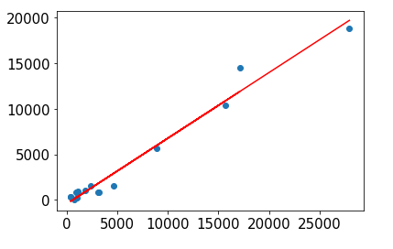
LINEAR REGRESSION B/W CONFIRMED
AND RCOVERED CASES

Slide 41
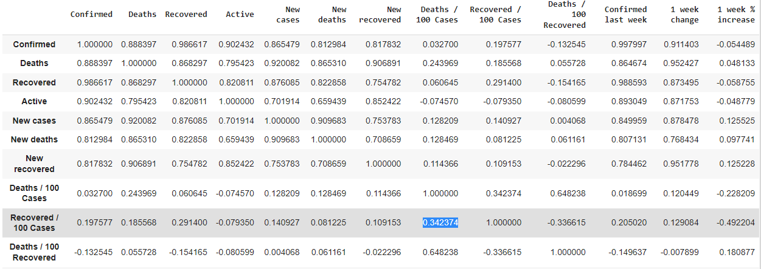
CORRELATION :-

Slide 42


Slide 43
DESCRIPTIVE AND STATISTICAL ANALYSIS
The American countries are :
Barbuda 9. Chile
Argentina 10. Colombia
Bahamas 11. Costa Rica
Barbados 12. Cuba
Belize 13. Dominicia
Bolivia 14. Dominican Republic
Brazil 15. Ecuador
Candad

Slide 44
Brazil is one of the countries of the America where large number of cases were confirmed in Jan 2020. It occupies a peak in America.
Secondly Colombia is found to be have increasing number of cases but still the situation is controlled.
One the other hand the rest of the countries have very less spread of covid-19 cases and the situation is highly controlled as compared to Brazil
We can clearly analyze it through a simple bar chart of confirmed cases of this region

Slide 45
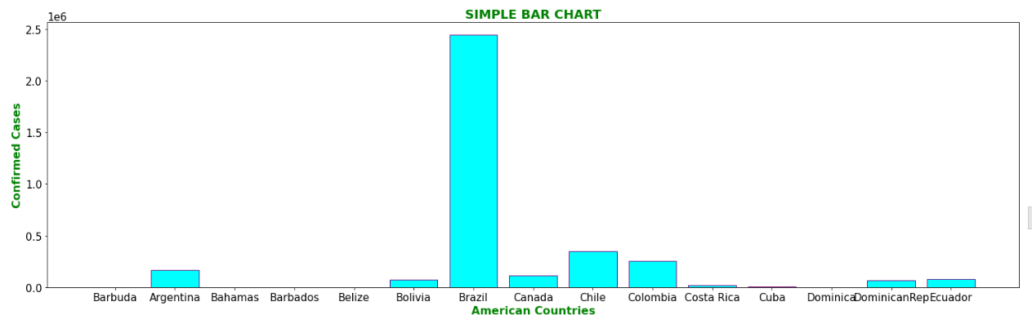

Slide 46
As discussed previously that the situation in Brazil was out of control but the death rate was not high
Many cases were recovered in Brazil .
Fortunately the rest of the countries are on the safe side with less active and deaths cases and mostly recovered cases

Slide 47
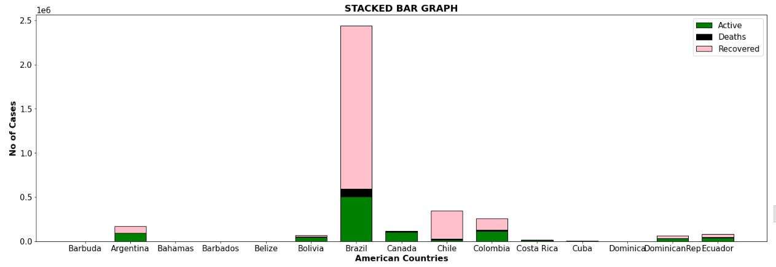

Slide 48
In the month of February the situation of Algeria was same as january and has the largest number of cases reported but the recovery ratio was much better than that of january
Death rate in whole America was very less and mostly cases were healed as compared to the report of January .
Whereas the countries where the situation was controlled in January were still safe from this virus means no change .

Slide 49
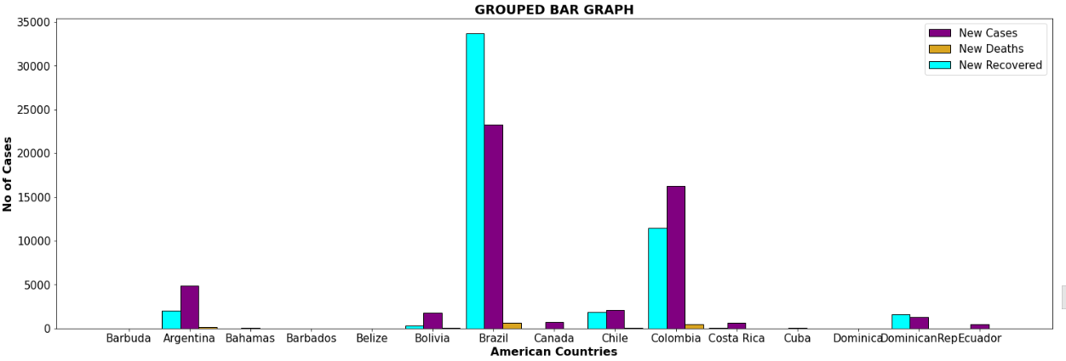

Slide 50
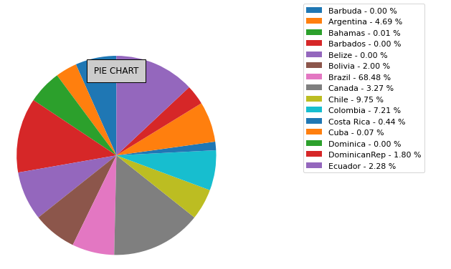
PIE CHART OF DEATHS / 100 Cases

Slide 51
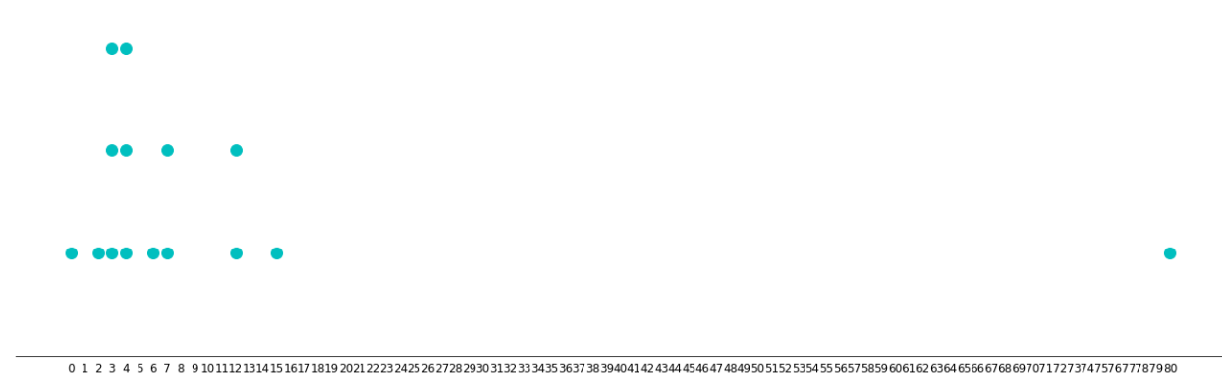
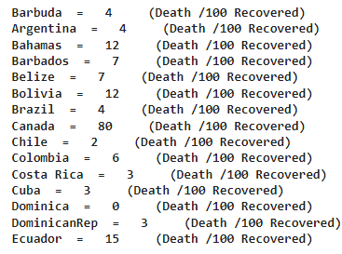
DOT PLOT OF DEATHS / 100 RECOVERED

Slide 52
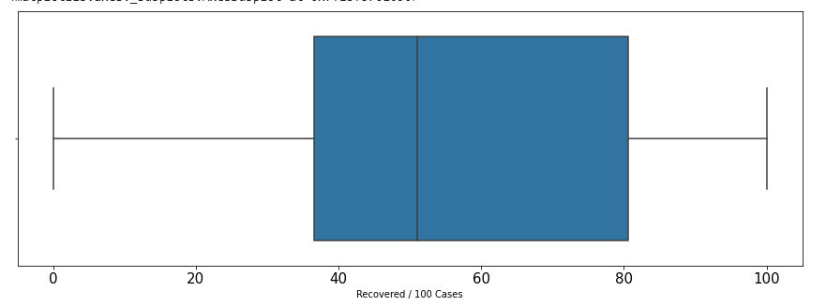
BOX PLOT OF RECOVERED / 100 CASES

Slide 53
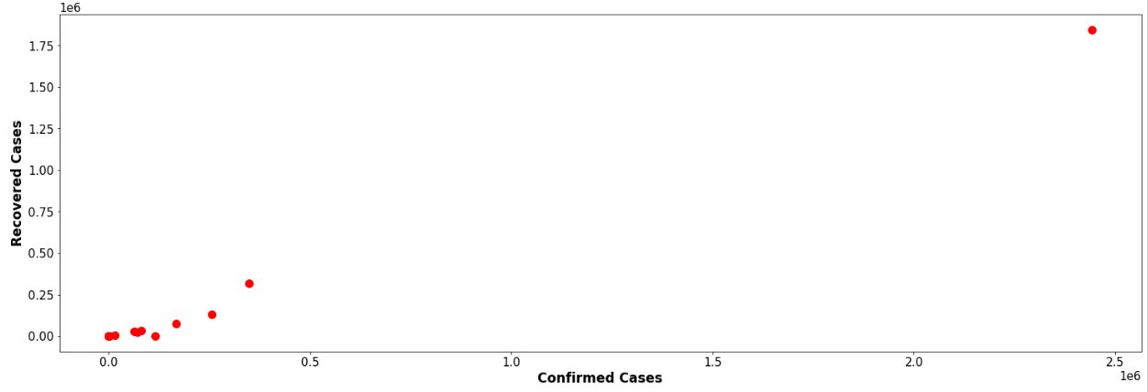
SCATTER PLOT B/W CONFIRMED
AND RECOVERED CASES

Slide 54
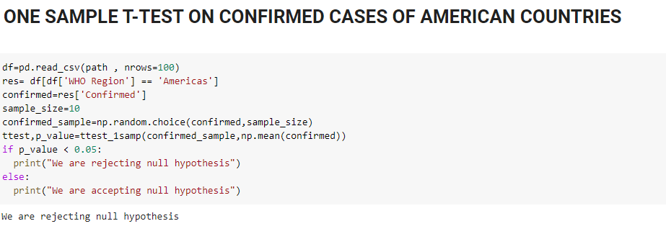
HYPOTHTETICAL TESTING

Slide 55
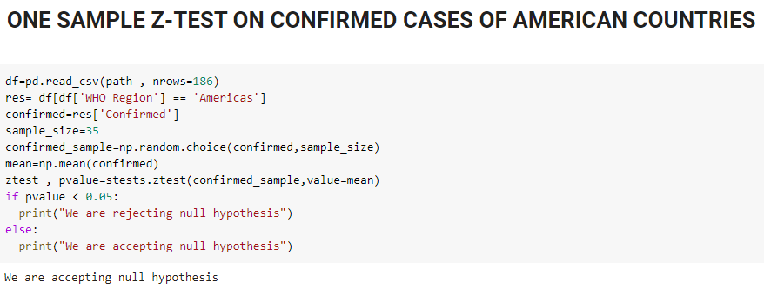

Slide 56
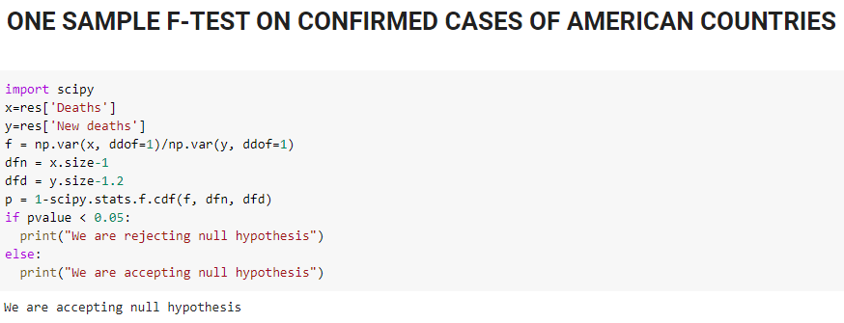

Slide 57
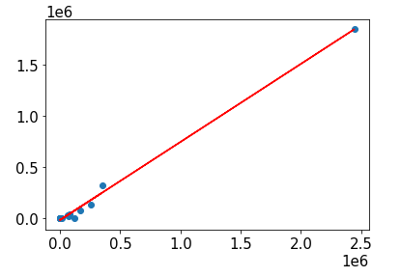
LINEAR REGRESSION B/W CONFIRMED
AND RCOVERED CASES

Slide 58
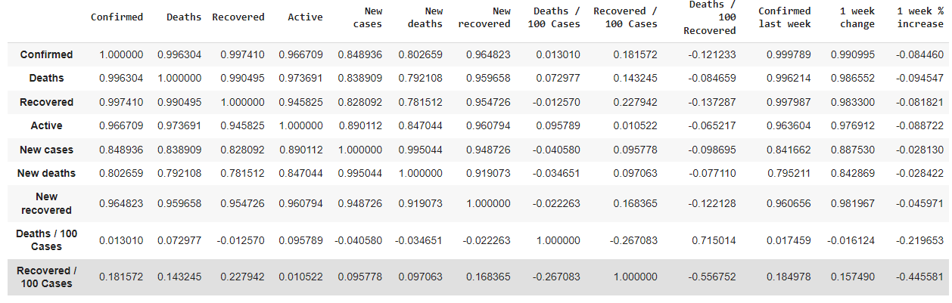
CORRELATION :-

Slide 59
WHY WE USE GRAPHICAL ANALYSIS ?
To facilitates and improve learning
Graphics make data easy to understand and eliminate language and literacy barriers
Understanding content : visuals are more effective than text in human understanding
For rapid visualization of our dataset

Slide 60
REFRENCES
https://www.tandfonline.com/doi/full/10.1080/10408363.2020.1783198?scroll=top&needAccess=true
https://www.tandfonline.com/doi/full/10.1080/22221751.2020.1775132?scroll=top&needAccess=true
https://journals.sagepub.com/doi/full/10.1177/2347631120983481
https://link.springer.com/article/10.1007/s11125-020-09464-3/

Slide 61
THANK YOU !

